Slide 1
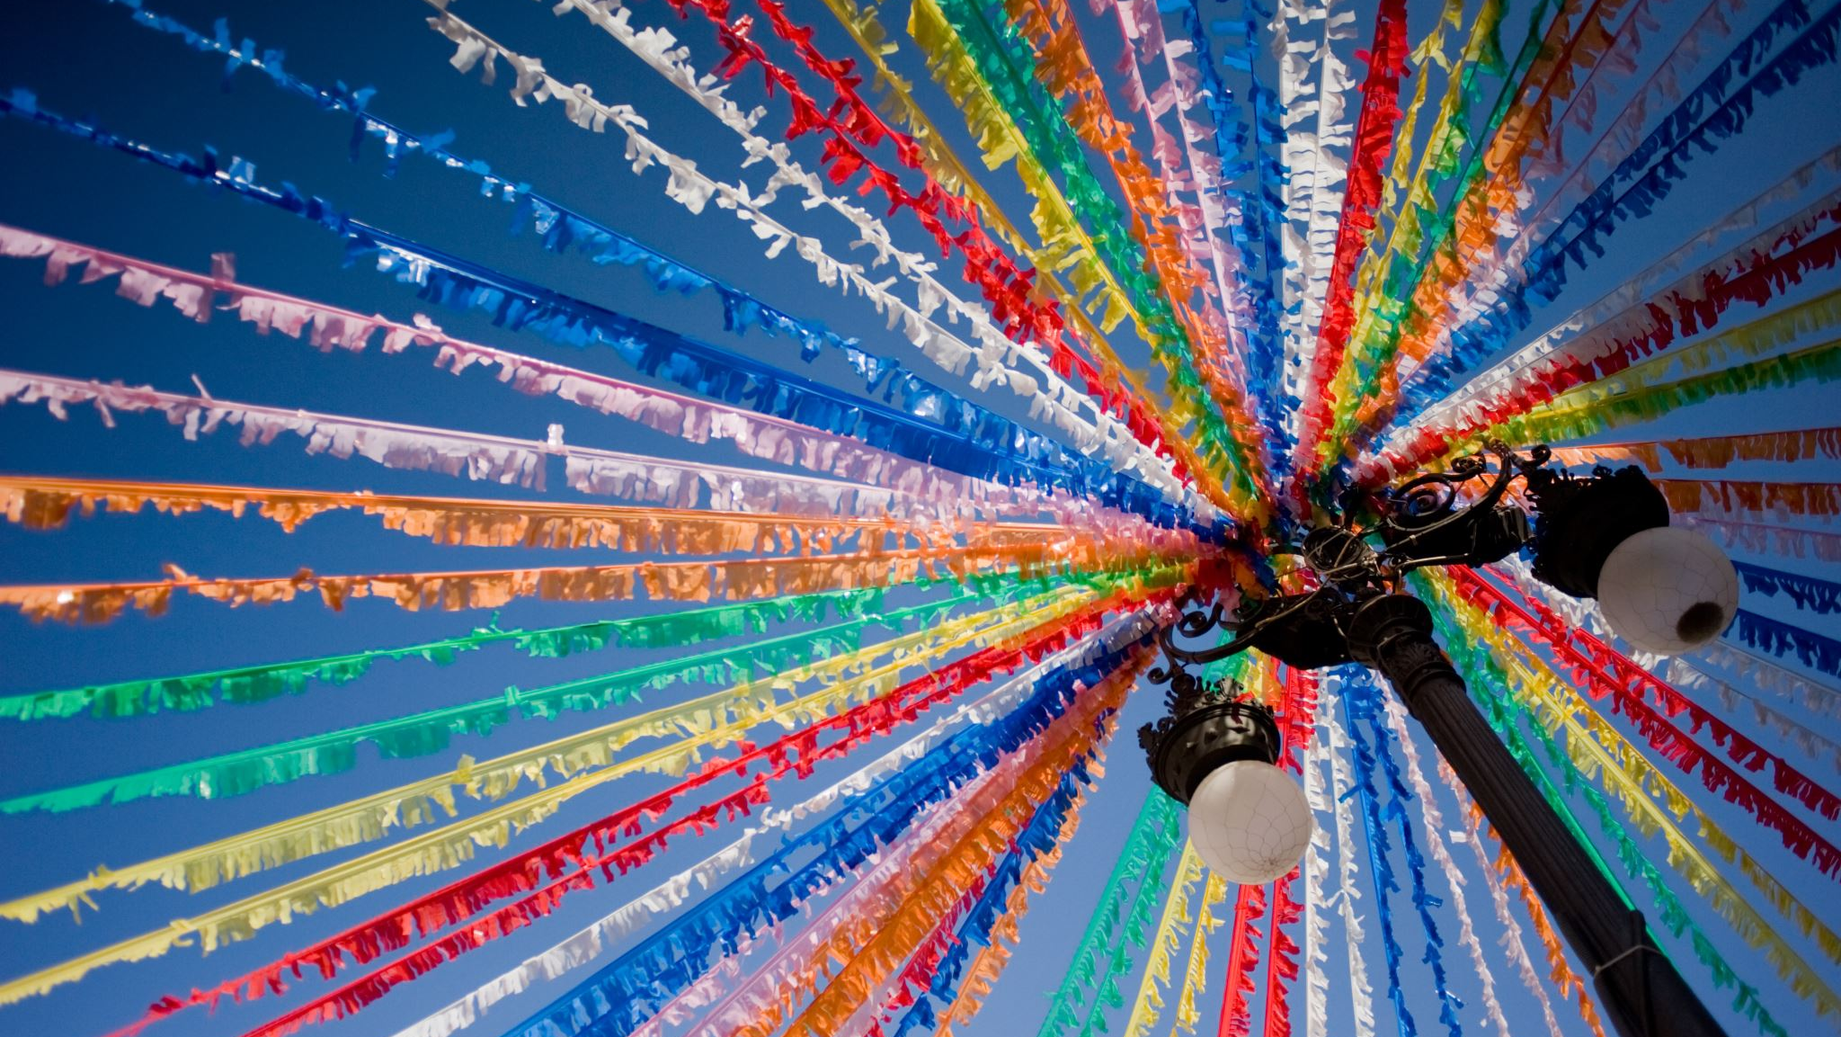
Festival of hope
By class 7b

Slide 2
What is festival of hope?
The Festival of Hope is a festival which introduces young people to the heart of design, programming and production. It brings together diverse cultures and voices from across the globe – hosting interviews, workshops and opportunities for action. The discussions are framed around topics such as climate change, peace, well-being, technology and justice.
The festival is designed to unite youth in this challenging time. It’s about creating connections and hope.
With opportunities to engage virtually and in person, the first season of events will run until February 2023. The Festival of Hope is more than a single event, it is a community of young people, educators, global thinkers, artists, government leaders, and everyone else who feels the urge to be part of change. It’s a supportive space for communicating big ideas, exchanging diverse views, and inspiring action.

Slide 3
There is always hope
Hope accompanies every human being through out their lives. It is a strength that allows you to overcome your own weaknesses. Thanks to hope, we rise after disastrous falls. It is magnificent yet inexplicable, we cannot destroy it and we all have a right to it.
Hope is the good during difficult moments in life, hope can comfort and encourage us. Thanks to hope, we are able to follow our goals, we are able make our dreams come true - although it can be challenging.
Hope is something everyone has. It makes us believe that when bad days come, there will be good ones too. Often hope creates miracles ex curing illnesses.
Hope makes us optimistic even when we have our bad days.
Hope is our support. It supports you spiritually and emotionally.

Slide 4
Hope in media
Media is a big part of everyday life and when used correctly can influence someone's feelings. Cadbury did just that with their ad campaign "This doesn’t need to end" They gave hope to the citizens of Britain during the lockdown. With quotes such as "When the lockdown is over this doesn't have to be over" and "There a glass and a half in everyone" The campaign really gave hope to those suffering during the lockdown.

Slide 5
Hope in kids
Hope in children lies in believing in their abilities to help other and their abilities to change the world. Children can learn this through daily care about nature.
Young people see other possibilities for problems and disputes. They have a lot of sensitivity and empathy towards people, animals and plants.
It is important that the children develop with a sense of hope and optimism.

Slide 6
Hope in people with disabilities
People with disabilities work very hard to participate fully in society and live as non-disabled people. The truth is that every person is unique in their own way and we need to be able to notice that.

Slide 7
Hope in music
Since the start of our age, music has given humans hope. Hope for a better tommorow, for success in gathering food, hope for success during war.
During war music helped calm people and gave hope during battles. Insurgent songs accompanied young people during the planned military action. Songs that encouraged a hero like attitude gave hope for their next success.
The most recognizable exaple of hope in music is Live Aid. It gave hope tostarving kids in Ethiopia, hope for a better future.
Live Aid were two parallel rock concerts organized on July 13, 1985, at Wembley Stadium (72,000 people) in London and JFK Stadium (90,000 people) in Philadelphia. An estimated 1.5 billion people from 100 countries watched the celebrity performances televised.
Queen's famous performance at Live Aid has been voted the best rock concert of all time. During this performance, Queen singer Fredie Mercury got 72,000 spectators to clap in unison to the song "Radio Ga Ga".

Slide 8
Hope in education
Most often, hope in education comprises of getting good grades, success in their test, etc. We do not always succeed, but we always have hope in the back of our minds. But what is hope in education in general? The hope for students is to achieve success, get to a good university and aquiring knowledge. Most often, such faith/hope is spoiled by difficulties or fatigue. Hope in education should give us the idea that something will work out. Is it so? Well, it depends.

Slide 9
Hope in sports
Hope in sports is the belief that a team, athlete, or individual can achieve success through hard work, determination and talent. It is the drive to do better and to never give up in the face of adversity. It is the belief that no matter the odds, anything is possible if you just keep pushing forward. Hope in sports is an essential part of achieving success and keeping a team or individual motivated. With hope, a team or athlete can find the strength to push themselves to their limits and reach their goals. Hope can be a powerful force in helping to achieve greatness

Slide 10
Hope there and now
Hope is an essential part of life. It helps us to keep going and stay positive, even in uncertain times. It can be found in small moments, like when a loved one sends a text or when we discover a new hobby. It can also be found in moments of joy, such as when we achieve a goal or when we share a special moment with someone we care about.

Slide 11
What is hope?
"Hope is being able to see that there is light despite all of the darkness.„- Desmond Tutu

Slide 12
Bibliography
https://www.who.int/initiatives/eios/global-technical-meeting-2019/presentations/social-media-hope-or-hype
https://media-is-hope.org/
https://festivalofhope.co.uk/about/
https://www.ibo.org/festival-of-hope/

Slide 13
Thank you For your attention
Class 7b

